Slide 1
911 Grant Program
Voucher Reduction
User Training

Slide 2
Voucher Reduction Functions

Slide 3
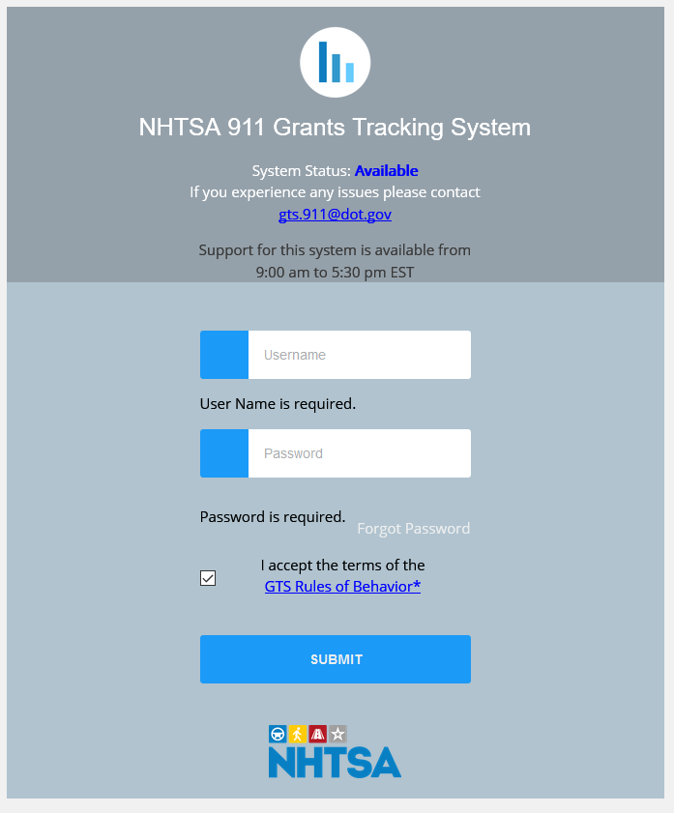
Log in
Enter Username
Enter Password
Click “I accept the terms of the GTS Rules of Behavior”
Click “Submit”

Slide 4
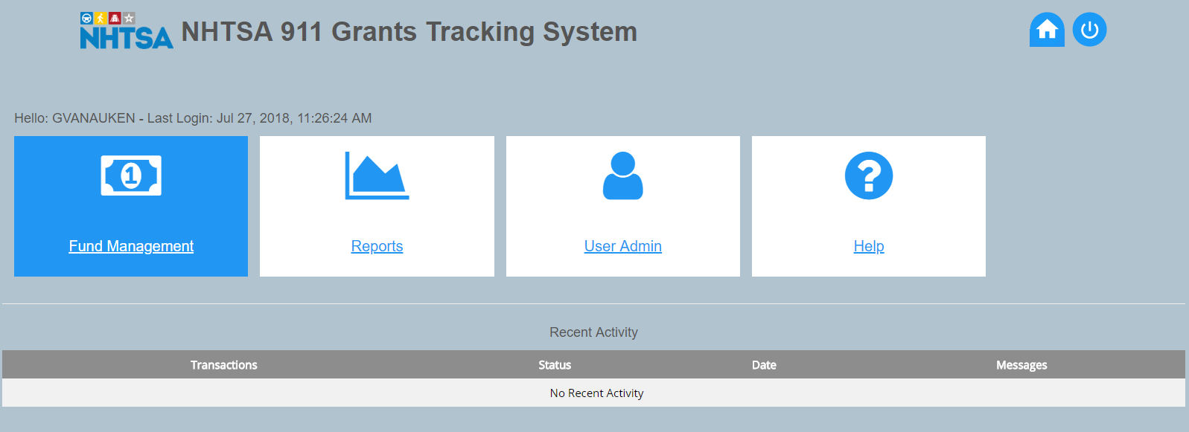
Dashboard
Fund Management
Reports
User Admin
Help
Recent Activity
Home Button
Log Out Button
Notes:
ALWAYS log out and close browser for security

Slide 5
Vouchering
The voucher transaction allows awardees to electronically submit vouchers for reimbursement of project expenses.
All project vouchers must be submitted before the end of the grant period.
The spending plan must be approved and posted before a voucher can be submitted for a project.

Slide 6
Vouchering: Two Steps
Complete Standard Form 270 (download form and instructions from GTS) and submit completed form via the nhtsa.national911@dot.gov email address.
Enter voucher data via Grants Tracking System.
(Video will be provided on how to complete SF270)

Slide 7
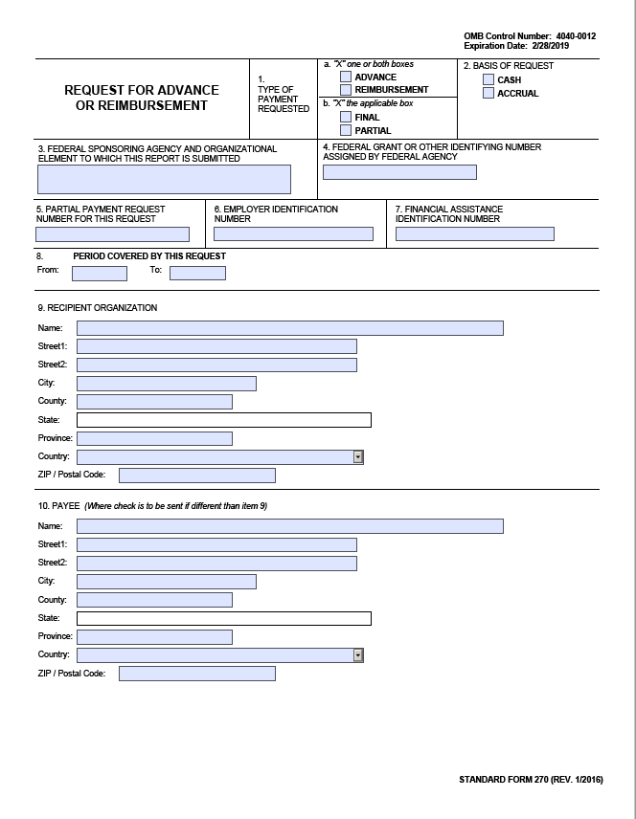
Standard Form 270

Slide 8
Two Types of Vouchers
Progress Voucher – Submitted while the grant project is in process. (This is when a voucher reduction will take place.)
Final Voucher – Only submitted once—after the entire grant project is complete and it is time for project closeout.
Only one voucher can be submitted at a time.
Each voucher may contain multiple invoices.

Slide 9
Vouchers
Each voucher is posted and submitted individually and requires the project number and program in which the funds were expended.
Submitting a voucher for payment, both payment and matching funds, or matching funds only are entered the same way.

Slide 10
Creating a Voucher
On the Fund Management page, click the “Create a Voucher” button below the plan.

Slide 11
Voucher Form
Click “Add New Voucher Entry”
Enter each line as needed

Slide 12
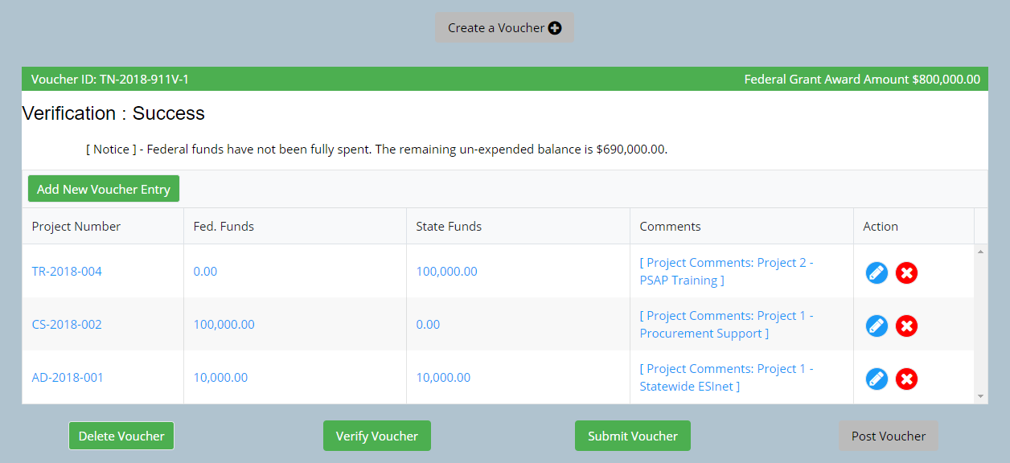
Voucher Line Actions
Select one of the two options, either a “check mark” or the “X.”
Click the “check mark” to accept the information entered.
Click the “X” to delete the line.
A “pencil” will appear in place of the “check mark” after accepting the line. The pencil icon will be used to edit line information.
The “Delete Voucher” button will delete all lines entered. Use caution. It is better to delete one row at a time unless there are major issues.

Slide 13
Voucher Reduction, Part 1
During the period of performance, there may be a need to correct your GTS vouchers by entering a voucher for a negative amount (voucher reduction). This can result from either:
A grantee making a mistake in the financial data entered into the GTS that needs to be corrected
A grantee must reimburse federal funds to NHTSA and the grantee is still eligible to receive these grant funds
It is a good practice to coordinate with the Office prior to submitting a voucher reduction.

Slide 14
Voucher Reduction, Part 2
There are two types of these vouchers:
Net Negative Voucher
Net Positive Voucher
Certain voucher reductions require a standalone negative voucher. Coordinate with the Office prior to submitting a voucher reduction.

Slide 15
Net Negative Voucher

Slide 16
Create a Voucher Reduction
The grantee will submit a voucher normally, with the exception of entering a negative number in the funds fields by placing the minus sign (-) in front of the number. A comment to explain the negative entry is recommended.

Slide 17
Verify Voucher
After all lines are entered, click the “Verify Voucher” button. This will verify that the formulas are valid.
Remember only one voucher may be submitted at a time.

Slide 18
Net Negative Voucher Verification
Notes:
Create a new voucher and enter each line as required to complete the voucher. Verify the voucher as normal. The verification will show a failure until the “Return Funds” function is completed in the GTS.

Slide 19
Return Funds, Part 1
To successfully submit the voucher, you will need to enter the information regarding your payment.
Have the information for the payment available or conduct the transaction simultaneously with making the payment.
If the grantee must reimburse federal funds to NHTSA, there are two options for the reimbursement:
Send Check (to NHTSA)
Electronic Transfer (of funds)
Return funds is NOT needed if only state funds are impacted.
Notes:
Helpful Hint
When submitting a voucher that will return funds, it is best to enter the information on the voucher and assure it is correct.
Then save the voucher and process the payment method with your appropriate agencies. This will provide you with the information needed to complete the return of funds on the voucher.

Slide 20
Return Funds, Part 2
The return funds screen displays:
Amount of funds to be returned
Send Check Button
Electronic Transfer Button

Slide 21
Return Funds – Send Check
Enter the following payment information:
• Check Number
• Check Date (MM/DD/YYYY)
• Check Amount

Slide 22
Sending Checks
When sending a check to NHTSA, the grantee should provide the following information with the check:
Grantee Name
Grant Number/Referred to as PO number by NHTSA/Unique Federal Award Identification Number (FAIN) on the award documents
Date of Check
Check Number
Amount Reimbursed via Check
The check should be sent to:
Attention Account Receivable
DOT/FAA/MMAC
6500 S MacArthur Blvd, Room 181
Oklahoma City, OK 73169
Attn: Judy Weggesser

Slide 23
Return Funds – EFT
Enter the following payment information:
• Transfer Number
• Transfer Date
• Transfer Amount

Slide 24
Electronic Funds Transfer
To transfer funds electronically to NHTSA, the grantee should use the following website:
https://www.pay.gov/public/home

Slide 25
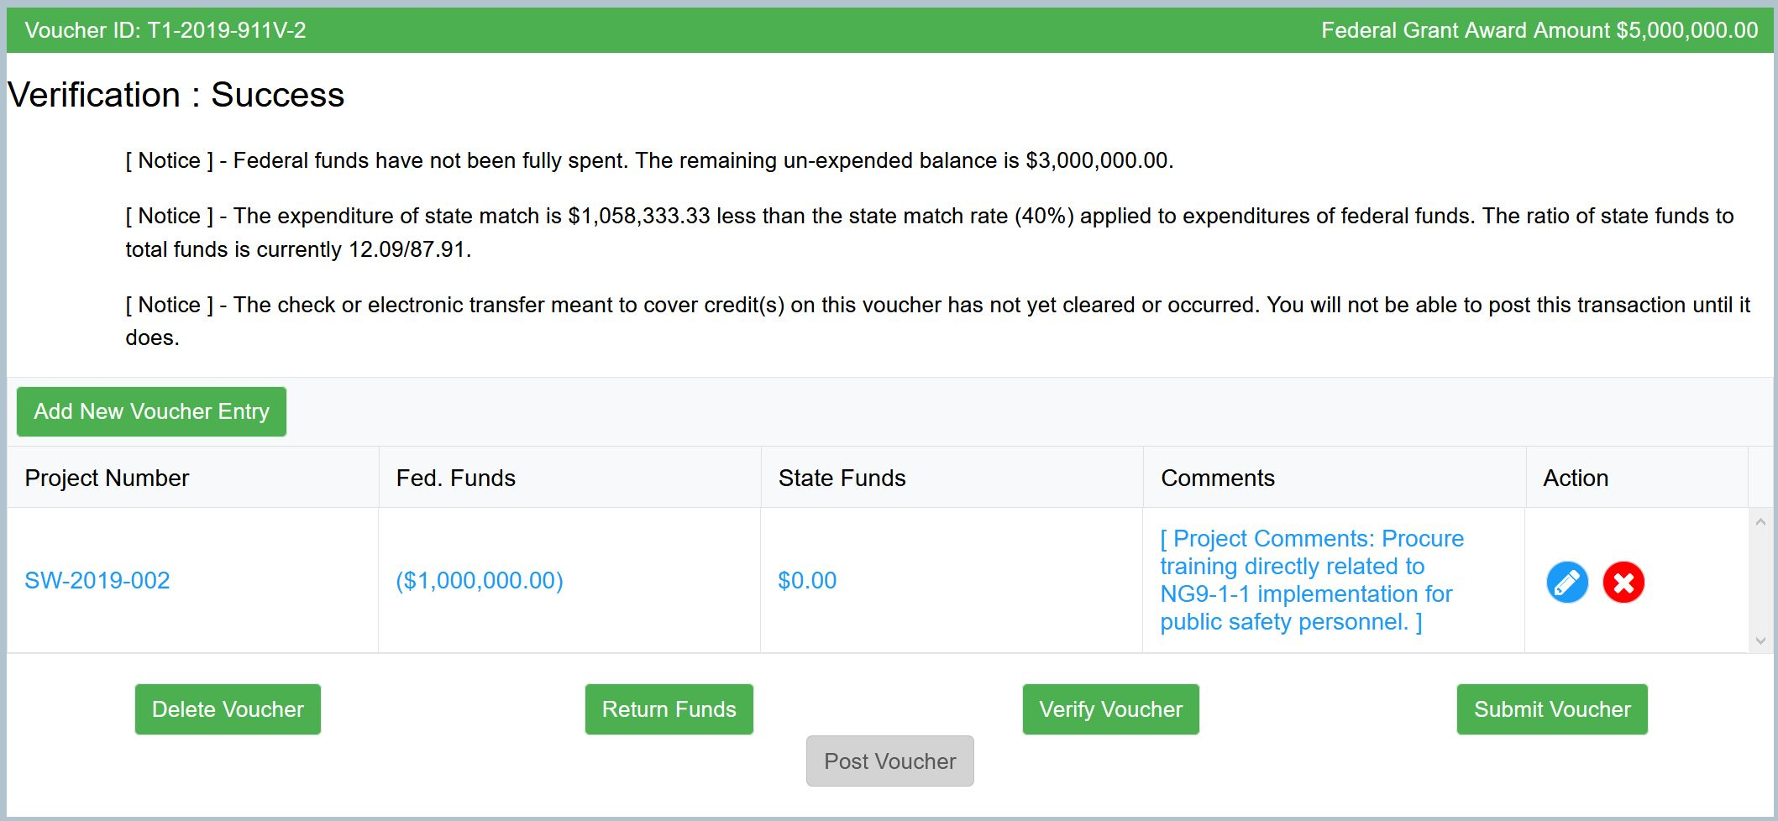
Final Voucher Verification
After all lines are entered, click the “Verify Voucher” button. This will verify that the formulas are valid.
Remember only one voucher may be submitted at a time.

Slide 26
Verify Voucher – Net Negative
A notice on the verification reads: “The check or electronic transfer meant to cover credit(s) on this voucher has not yet cleared or occurred. You will not be able to post this transaction until it does.”
Important Note: The grantee will not be able to post the voucher (even after approved), until NHTSA has been notified that the check has been received and it has cleared.

Slide 27
Submit Voucher – Net Negative
After the voucher is verified, click “Submit Voucher.”

Slide 28
All Payments
Immediately after the voucher is complete, an email should be sent to NHTSA (nhtsa.national911@dot.gov) to notify NHTSA that a payment is being sent.
It is important to include any tracking numbers connected to the delivery mechanism used to send the check and the following:
Grantee Name
Grant Number/Referred to as PO number by NHTSA/Unique Federal Award Identification Number (FAIN) on the award documents
Date of Payment
Check Number or Transfer Number
Amount Reimbursed

Slide 29
Post Voucher – Net Negative
After the voucher is approved, it can be posted for payment.
Voucher Reductions require the payment to have cleared and the funds deposited before it can be posted.
Click “Post Voucher.”

Slide 30
Net Positive Voucher

Slide 31
Net Positive Voucher, Part 1
Some grantees may have expenditures and reductions and can put these on a single voucher. If this is the case, the total transaction of the voucher may result in a net positive amount.
For each line of the voucher, enter the expenditures as normal. To enter a negative number for reductions in the funds fields, place the minus sign (-) in front of the number. A comment to explain the negative entry is recommended.
It is good practice to coordinate with the Office prior to submitting a voucher reduction to ensure a standalone reduction is not needed.

Slide 32
Net Positive Voucher, Part 2

Slide 33
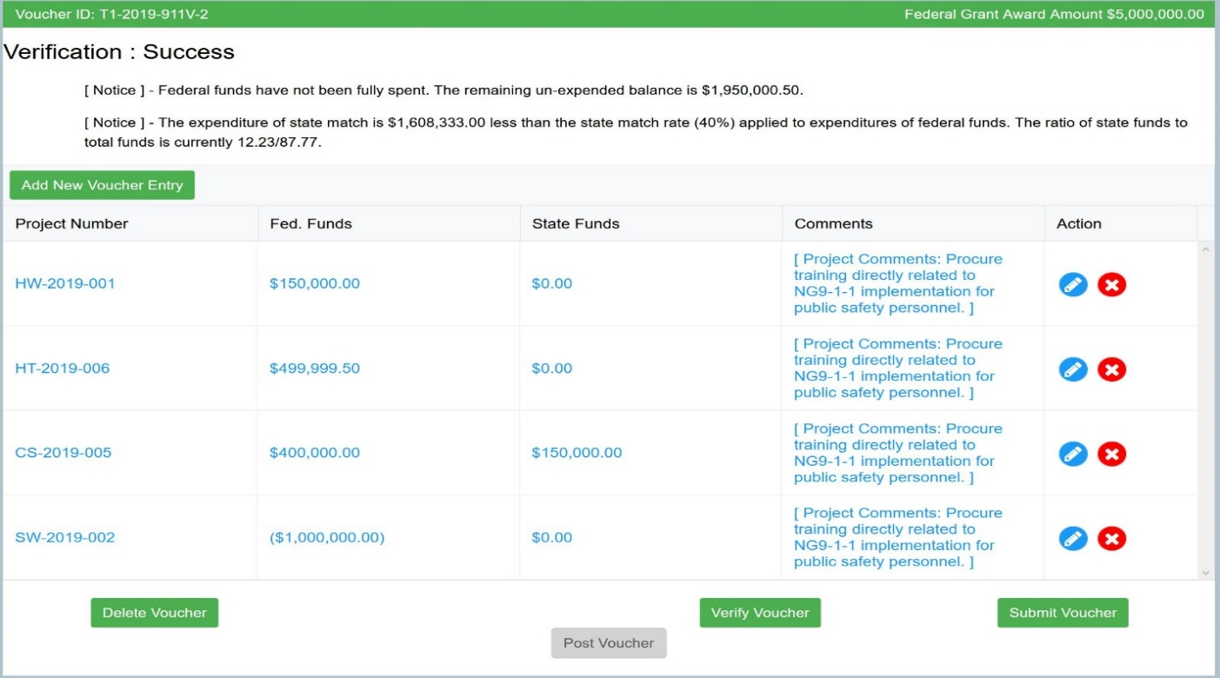
Verify Voucher – Net Positive
After all lines are entered, click the “Verify Voucher” button. This will verify that the formulas are valid.
Remember only one voucher may be submitted at a time.

Slide 34
Submit Voucher – Net Positive
After the voucher is verified, click “Submit Voucher.”

Slide 35
Post Voucher – Net Positive
After the voucher is approved, it can be posted for payment.
Click “Post Voucher.”

Slide 36
Resources
Final Rule
Notice of Funding Opportunity
911.gov website
GTS User Manual – on GTS login page
GTS webinar – archived link on GTS
SF270 video – link on GTS

Slide 37
Technical Support
gts.e911@dot.gov
Available
8:00 AM to 4:30 PM
Eastern Time
For website questions only!

Slide 38
How to Contact Us
Website: http://www.911.gov
Email: nhtsa.national911@dot.gov
Mail:
National 911 Program
1200 New Jersey Avenue, S.E., NPD-400
Washington, DC 20590
Notes:
UPDATE this

